Slide 1
Restaurant Management
Team :
1_mohamed ehab mohamed teama
2_mohamed salman Farhan
3_mohamed alaa eldein
4_omar nabil sharnopy
5_omar abdlmonaim
6_mohamed ahmed syam

Slide 2
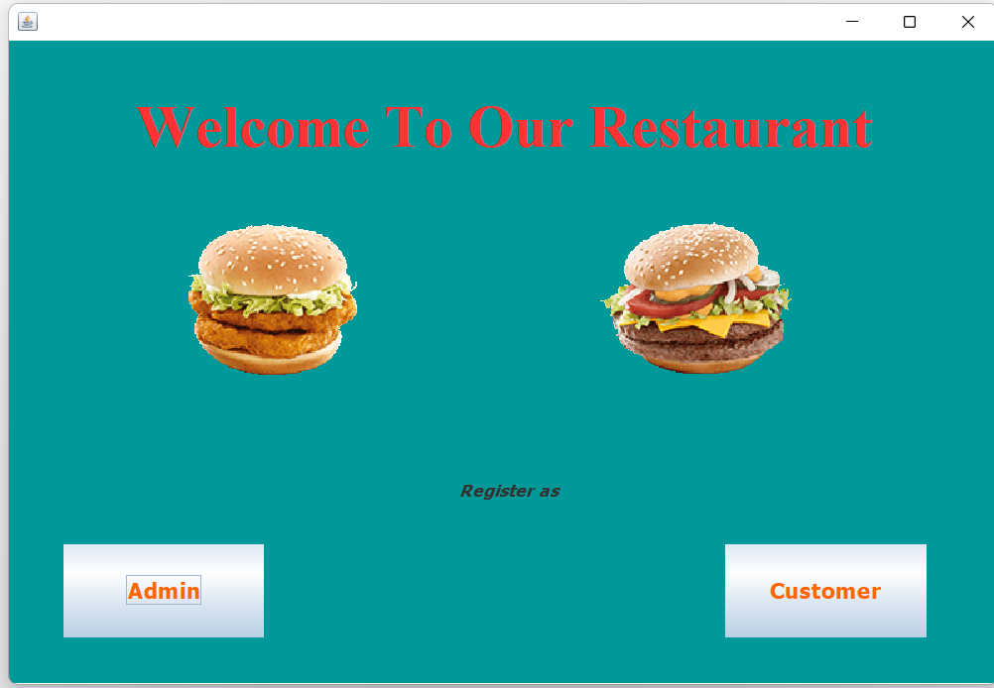

Welcome page
Login as customer
Set as admin

Slide 3
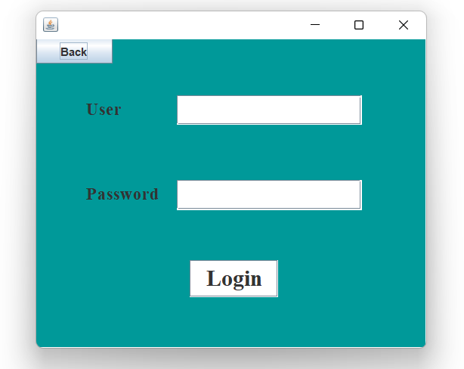
Login page as admin
Admin :
accesses to the admin page after the login page.

Slide 4
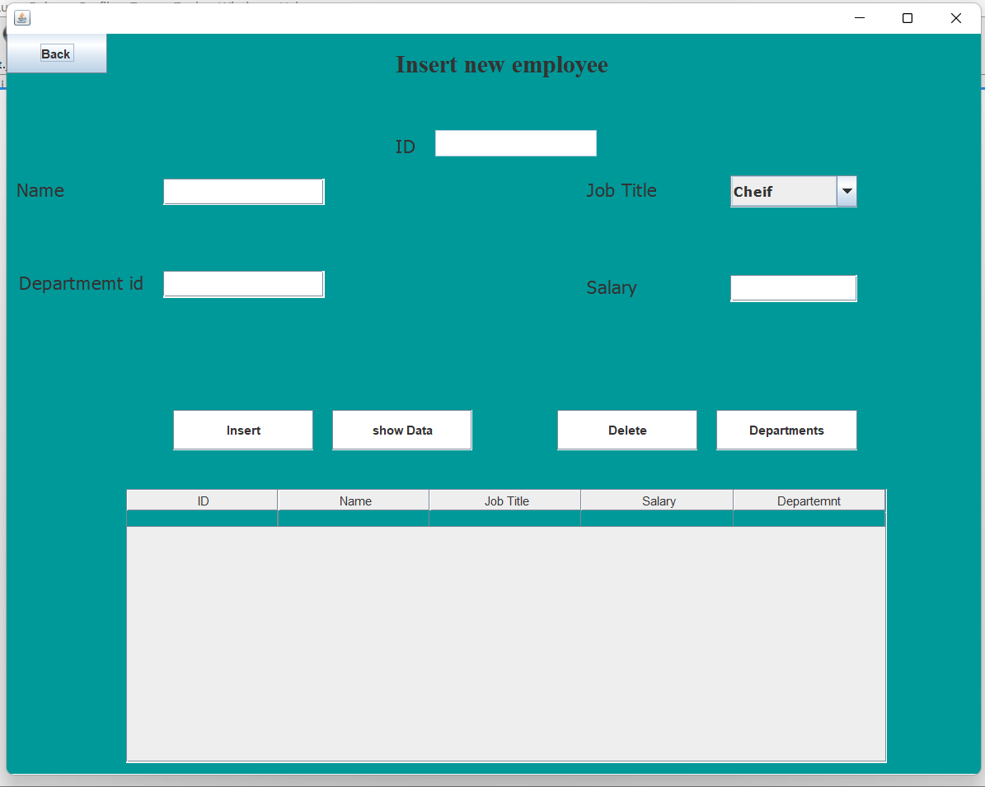
Customer page
_ admin accesses the information of the employee as there ID, names, salaries

Slide 5
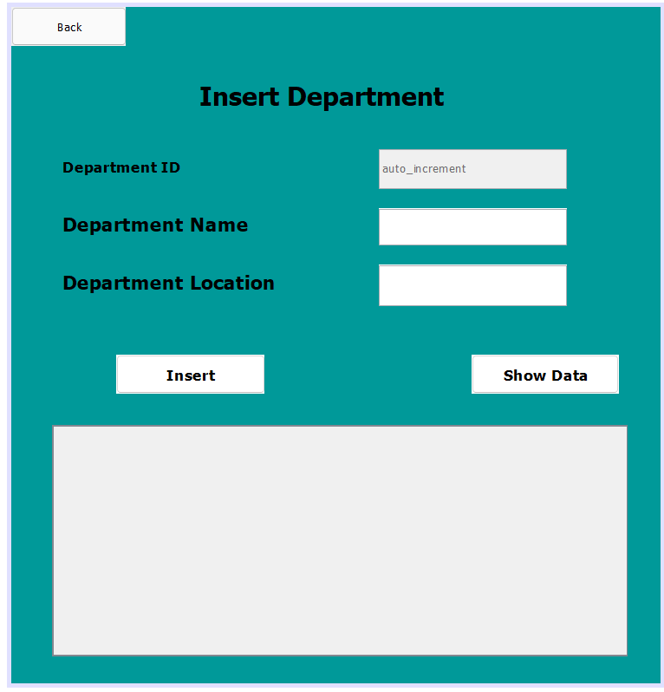
Department page
Departments
If you are one of the Admin you can go to the Admin Frame to the Departments frame to know about the Departments of the Restaurant.
There are Five Departments in the Restaurant which are:
1- management
2- hr
3- employee
In this Frame you can edit and insert new Department to the Restaurant

Slide 6
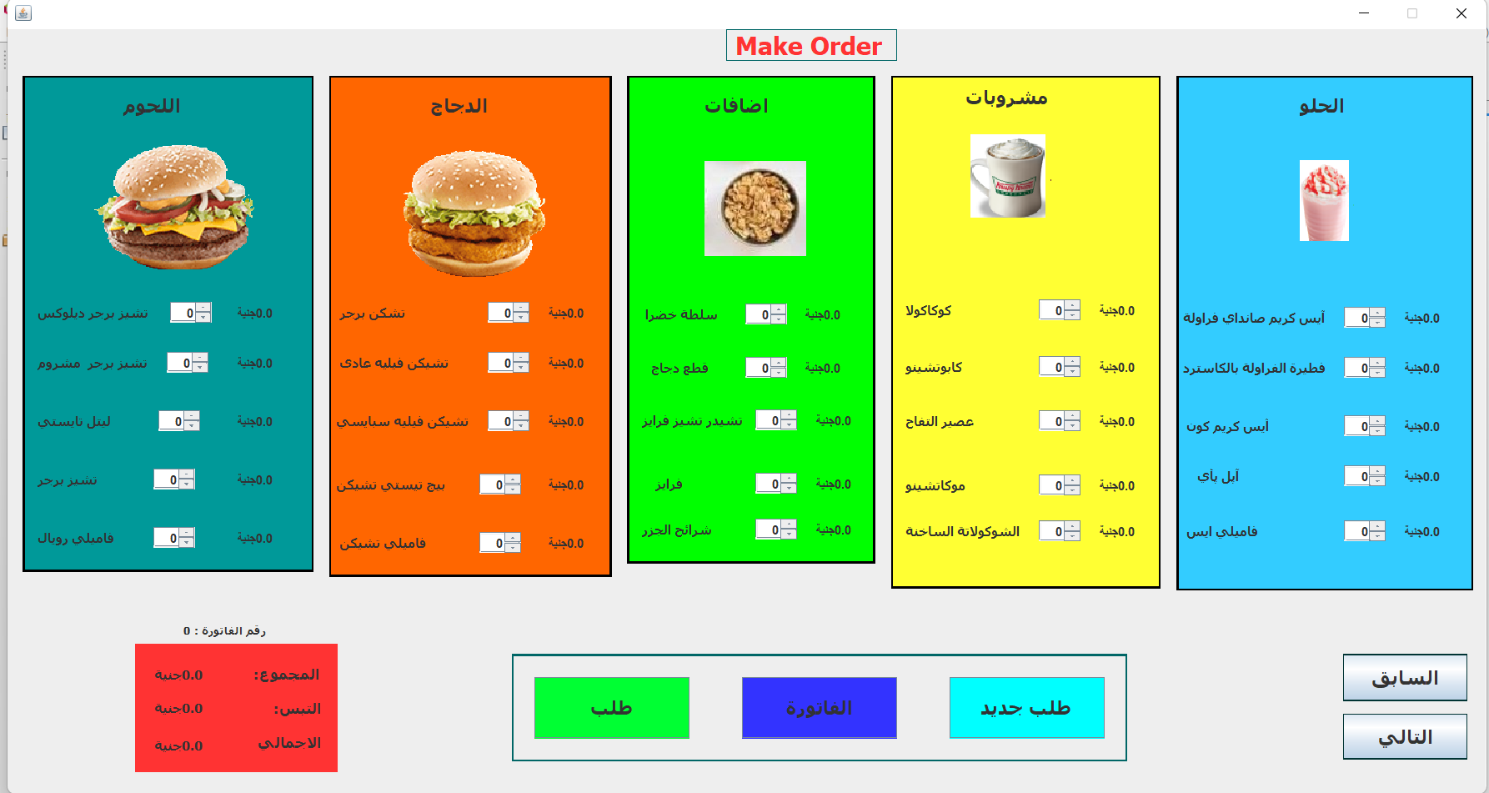
Order page
Customer:
At customer page you can order food after entering order, new order ,receipt, and choose category cheese or kitchen or extra or drinkes , delicious.
And next page is exit

Slide 7
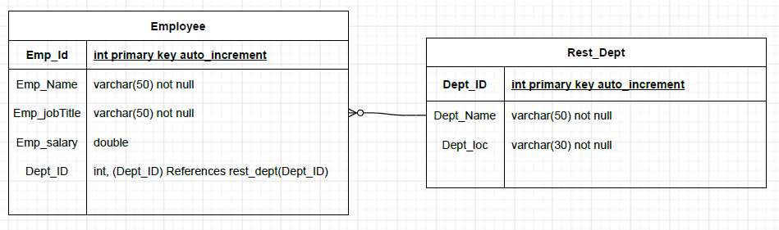
Database
The relation between employee table and rest_Dept(restaurant department) table is many to one respectively
Employee table:
Were the employee information
rest_Dept(restaurant department)
Were the department information at the restaurant

Slide 8
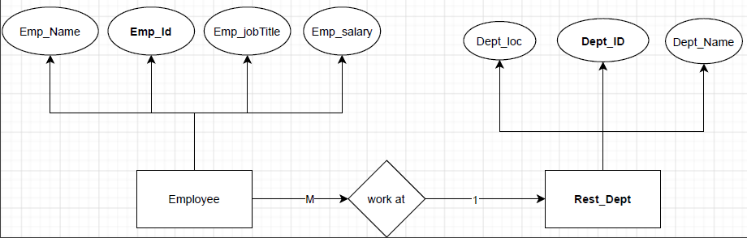
Database
The diagram represent the employee table and rest_dept table ; the relation between and entity

Slide 9
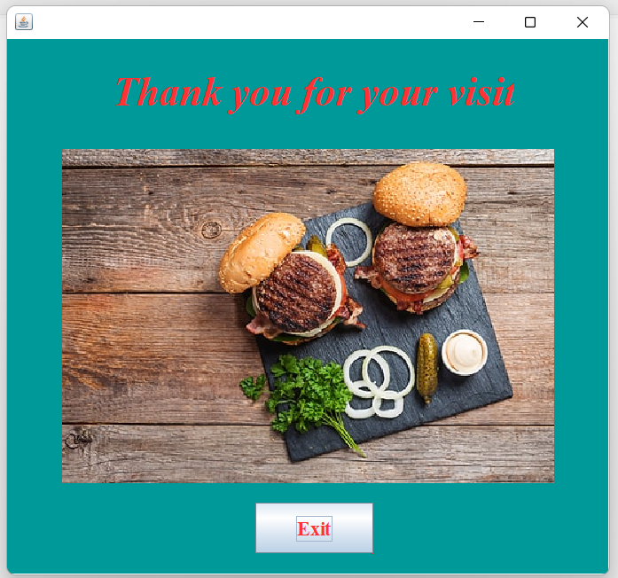
Exit page

